Slide 1
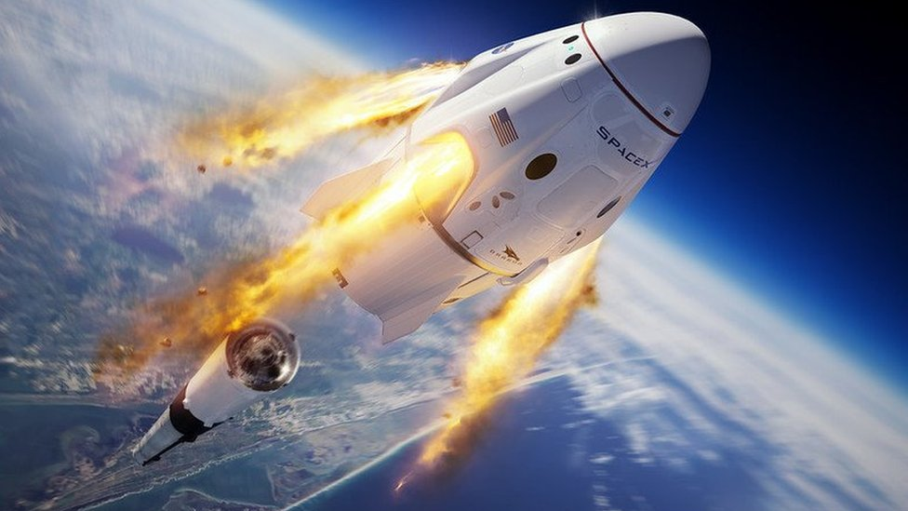

Daniel Leonardo Robelto Bayona
23 April 2023

Slide 2
Outline
Executive Summary
Introduction
Methodology
Results
Conclusion
Appendix
2

Slide 3
Executive Summary
Summary of methodologies
SpaceX Data Collection using SpaceX API
SpaceX Data Collection with Web Scraping
SpaceX Data Wrangling
SpaceX Exploratory Data Analysis using SQL
Space-X EDA DataViz Using Python Pandas and Matplotlib
Space-X Launch Sites Analysis with Folium-Interactive Visual Analytics and Ploty Dash
SpaceX Machine Learning Landing Prediction
Summary of all results
EDA results
Interactive Visual Analytics and Dashboards
Predictive Analysis(Classification)
3

Slide 4
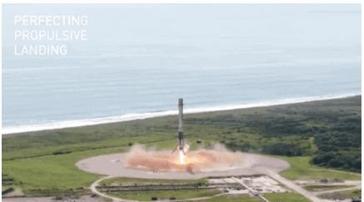
Introduction
Project background and context
SpaceX advertises Falcon 9 rocket launches on its website with a cost of 62 million dollars; other providers cost upward of 165 million dollars each, much of the savings is because SpaceX can reuse the first stage.
Therefore if we can determine if the first stage will land,
we can determine the cost of a launch. This information can be used if an alternate company wants to bid against SpaceX for a rocket launch.
Problems you want to find answers
In this capstone, we will predict if the Falcon 9 first stage will land successfully using data from Falcon 9 rocket launches advertised on its website.
4

Slide 5

5

Slide 6
Methodology
Executive Summary
Data collection methodology:
Describes how data sets were collected
Perform data wrangling
Describes how data were processed
Perform exploratory data analysis (EDA) using visualization and SQL
Perform interactive visual analytics using Folium and Plotly Dash
Perform predictive analysis using classification models
How to build, tune, evaluate classification models
6

Slide 7
Data Collection
Description of how SpaceX Falcon9 data was collected.
Data was first collected using SpaceX API (a RESTful API) by making a get request to the SpaceX API. This was done by first defining a series helper functions that would help in the use of the API to extract information using identification numbers in the launch data and then requesting rocket launch data from the SpaceX API url.
Finally to make the requested JSON results more consistent, the SpaceX launch data was requested and parsed using the GET request and then decoded the response content as a Json result which was then converted into a Pandas data frame.
Also performed web scraping to collect Falcon 9 historical launch records from a Wikipedia page titled List of Falcon 9 and Falcon Heavy launches of the launch records are stored in a HTML. Using BeautifulSoup and request Libraries, I extract the Falcon 9 launch HTML table records from the Wikipedia page, Parsed the table and converted it into a Pandas data frame
7

Slide 8
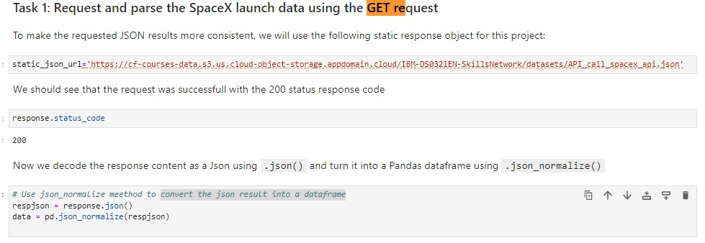
Data Collection – SpaceX API
Data collected using SpaceX API (a
RESTful API) by making a get request
to the SpaceX API then requested and parsed the SpaceX launch data using the GET request and decoded the response content as a Json result which was then converted into a Pandas data frame
Place your flowchart of SpaceX API calls here
Here is the GitHub URL of the completed SpaceX API calls notebook
(https://github.com/cgatama/SpaceX-
Falcon-9-1st-stage-Success-Landing-
Prediction/blob/main/1.%20Space- X%20Data%20Collection%20API.ipynb
)
8

Slide 9
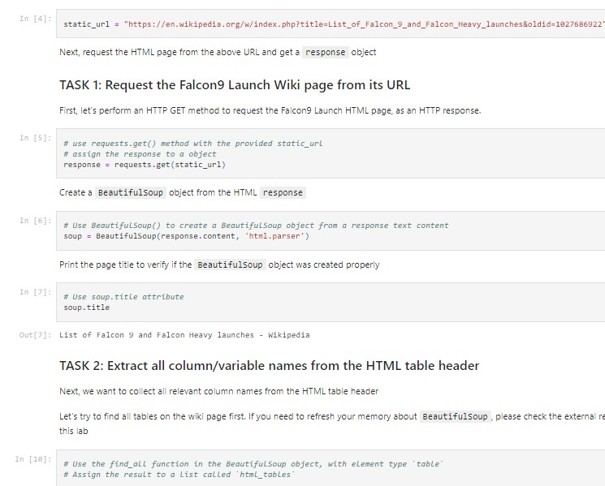
Data Collection - WebScraping
Performed web scraping to collect Falcon 9 historical launch records from a Wikipedia using BeautifulSoup and request, to extract the Falcon 9 launch records from HTML table of the Wikipedia page, then created a data frame by parsing the launch HTML.
Here is the GitHub URL of the completed web scraping notebook.
(https://github.com/cgatama/SpaceX-Falcon-9-1st-
stage-Success-Landing- Prediction/blob/main/2.%20Space- X%20Web%20scraping%20Falcon%209%20and%2 0Falcon%20Heavy%20Launches%20Records%20fr om%20Wikipedia.ipynb)
Place your flowchart of web scraping here
9

Slide 10
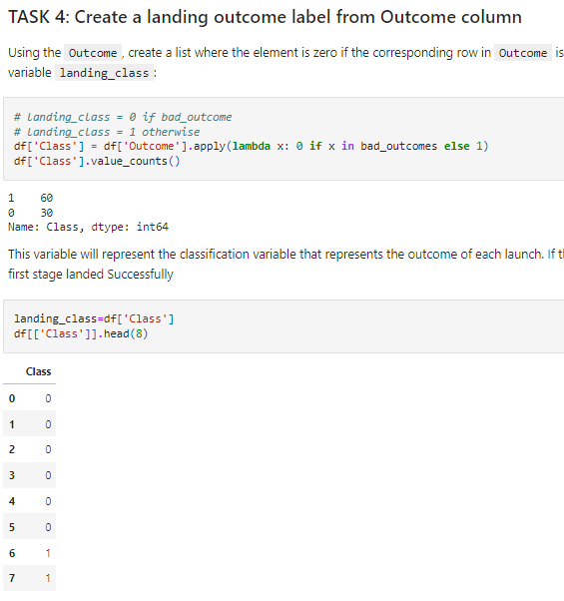
Data Wrangling
After obtaining and creating a Pandas DF from the collected data, data was filtered using the BoosterVersion column to only keep the Falcon 9 launches, then dealt with the missing data values in the LandingPad and PayloadMass columns. For the PayloadMass , missing data values were replaced using mean value of column.
Also performed some Exploratory Data Analysis (EDA) to find some patterns in the data and determine what would be the label for training supervised models
Here is the GitHub URL of the completed data wrangling related notebooks.

Slide 11
EDA with Data Visualization
Performed data Analysis and Feature Engineering using Pandas and Matplotlib.i.e.
Exploratory Data Analysis
Preparing Data Feature Engineering
Used scatter plots to Visualize the relationship between Flight Number and Launch Site, Payload and Launch Site, FlightNumber and Orbit type, Payload and Orbit type.
Used Bar chart to Visualize the relationship between success rate of each orbit
type
Line plot to Visualize the launch success yearly trend.
Here is the GitHub URL of your completed EDA with data visualization notebook,
(https://github.com/cgatama/SpaceX-Falcon-9-1st-stage-Success-Landing-Prediction/blob/main/5.%20Space-
X%20EDA%20DataViz%20Using%20Pandas%20and%20Matplotlib%20-%20SpaceX.ipynb)

Slide 12
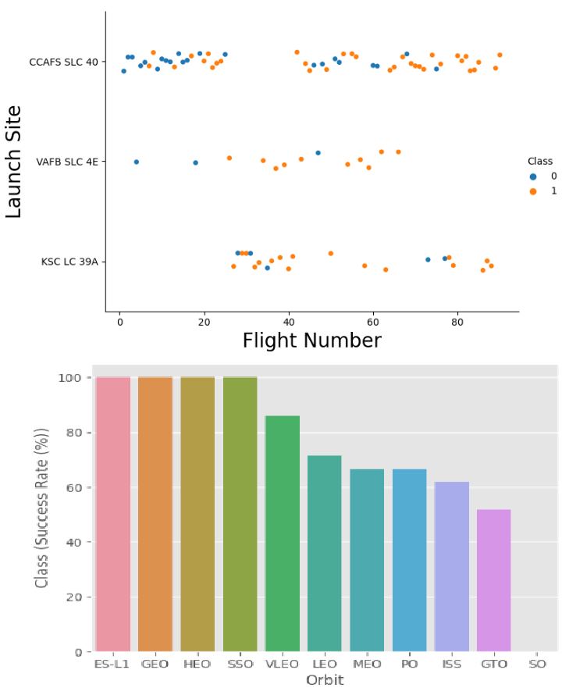
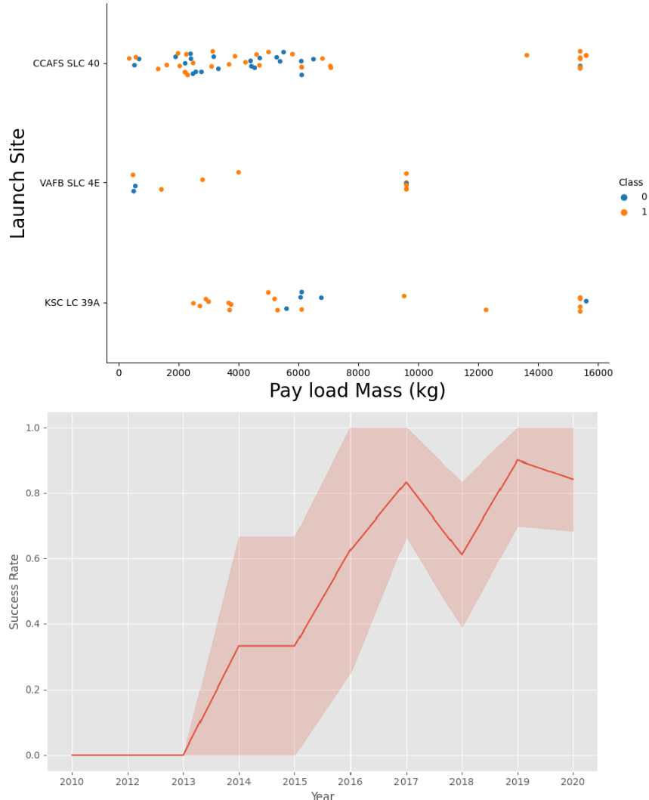
EDA with Data Visualization (Plots Cont….)

Slide 13
EDA with SQL
The following SQL queries were performed for EDA
Display the names of the unique launch sites in the space mission
Display 5 records where launch sites begin with the string 'CCA‘
Display the total payload mass carried by boosters launched by NASA (CRS)
Display average payload mass carried by booster version F9 v1.1

Slide 14
EDA with SQL (Cont.…)
List the date when the first successful landing outcome in ground pad was achieved
List the names of the boosters which have success in drone ship and have payload mass greater than 4000 but less than 6000 (%sql SELECT DISTINCT Booster_Version, Payload FROM SPACEXTBL WHERE "Landing _Outcome" = "Success (drone ship)" AND PAYLOAD_MASS KG_ > 4000 AND PAYLOAD_MASS KG_ < 6000;)
List the total number of successful and failure mission outcomes
Here is the GitHub URL of your completed EDA with SQL notebook.
(https://github.com/cgatama/SpaceX-Falcon-9-1st-stage-Success-Landing-Prediction/blob/main/4.%20Space-
X%20EDA%20Using%20SQL.ipynb)

Slide 15
Build an Interactive Map with Folium
Created folium map to marked all the launch sites, and created map objects such as markers, circles, lines to mark the success or failure of launches for each launch site.
Created a launch set outcomes (failure=0 or success=1).
Here is the GitHub URL of the completed interactive map with Folium map, as an
external reference and peer-review purpose (https://github.com/cgatama/SpaceX-Falcon-9-1st-
stage-Success-Landing-Prediction/blob/main/6.Space- X%20Launch%20Sites%20Locations%20Analysis%20with%20Folium-Interactive%20Visual%20Analytics.ipynb)

Slide 16
Build a Dashboard with Plotly Dash
Built an interactive dashboard application with Plotly dash by:
Adding a Launch Site Drop-down Input Component
Adding a callback function to render success-pie-chart based on selected site dropdown
Adding a Range Slider to Select Payload
Addeng a callback function to render the success-payload-scatter-chart scatter plot
Here is the GitHub URL of your completed Plotly Dash lab (https://github.com/cgatama/SpaceX-Falcon-9-1st-stage-Success-Landing-
Prediction/blob/main/7.%20Build%20an%20Interactive%20Dashboard%20with%20Ploty%20Dash%20-
%20spacex_dash_app.py)

Slide 17
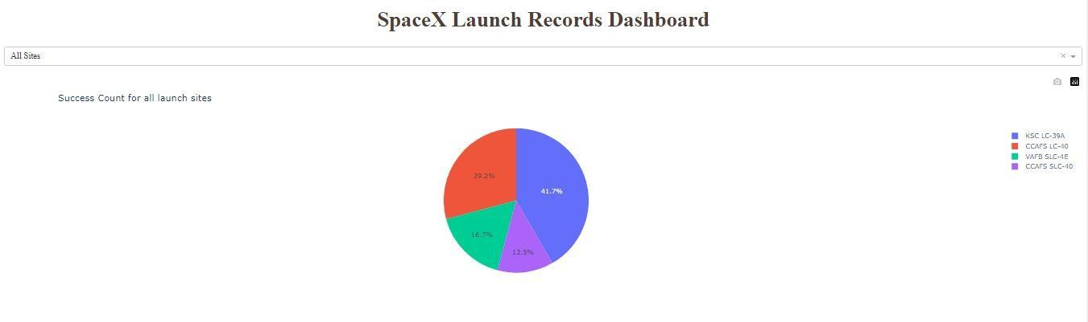
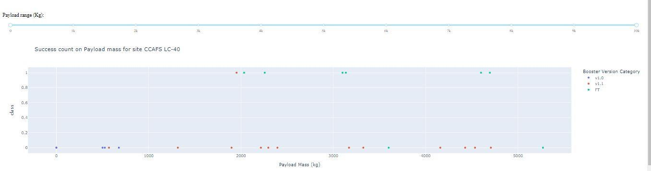
SpaceX Dash App

Slide 18
Predictive Analysis (Classification)
Summary of how I built, evaluated, improved, and found the best performing classification model
After loading the data as a Pandas Dataframe, I set out to perform exploratory Data Analysis and determine Training Labels by;
creating a NumPy array from the column Class in data, by applying the method to_numpy() then assigned it to the variable Y as the outcome variable.
Then standardized the feature dataset (x) by transforming it using preprocessing.StandardScaler() function from Sklearn.
After which the data was split into training and testing sets using the function train_test_split from sklearn.model_selection with the test_size parameter set to 0.2 and random_state to 2.

Slide 19
Predictive Analysis (Classification)
In order to find the best ML model/ method that would performs best using the test data between SVM, Classification Trees, k nearest neighbors and Logistic Regression;
First created an object for each of the algorithms then created a GridSearchCV object and assigned them a set of parameters for each model.
For each of the models under evaluation, the GridsearchCV object was created with cv=10, then fit the training data into the GridSearch object for each to Find best Hyperparameter.
After fitting the training set, we output GridSearchCV object for each of the models, then displayed the best parameters using the data attribute best_params_ and the accuracy on the validation data using the data attribute best_score_.
Finally using the method score to calculate the accuracy on the test data for each
model and plotted a confussion matrix for each using the test and predicted outcomes.

Slide 20
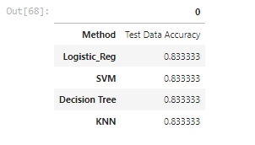
Predictive Analysis (Classification)
The table below shows the test data accuracy score for each of the methods comparing them to show which performed best using the test data between SVM, Classification Trees, k nearest neighbors and Logistic Regression;
GitHub URL of the completed predictive analysis lab (https://github.com/cgatama/SpaceX-Falcon-9-1st-stage-Success-Landing-
Prediction/blob/main/8.%20SpaceX%20Machine%20Learning%20Prediction.ipynb)
20

Slide 21
Results
Exploratory data analysis results
Interactive analytics demo in screenshots
Predictive analysis results
21

Slide 22

Section 2

Slide 23
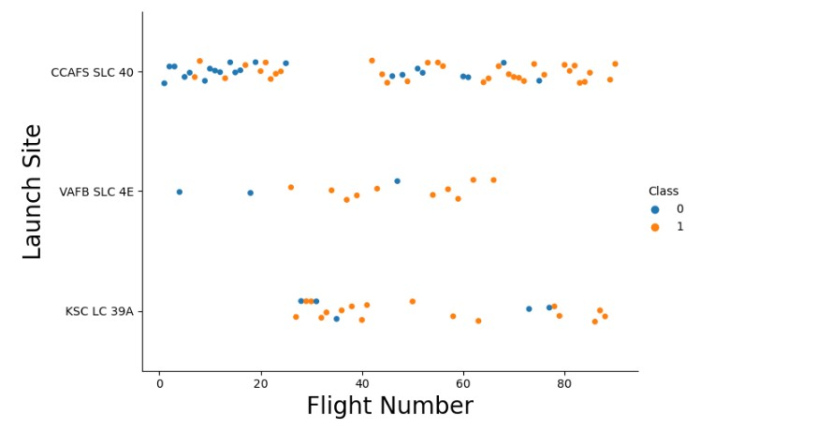
Flight Number vs. Launch Site
A scatter plot of Flight Number vs. Launch Site

Slide 24
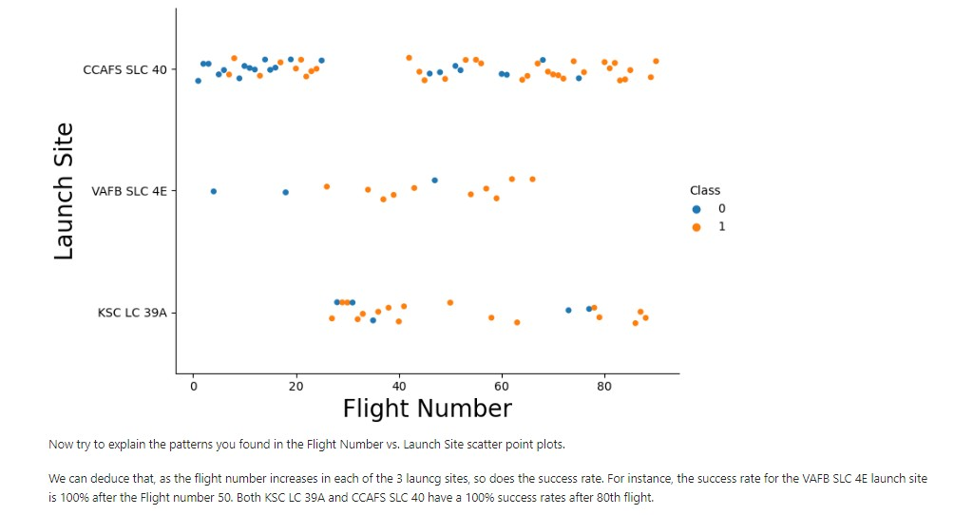
Flight Number vs. Launch Site with explanations
A scatter plot with explanations Flight Number vs. Launch Site

Slide 25
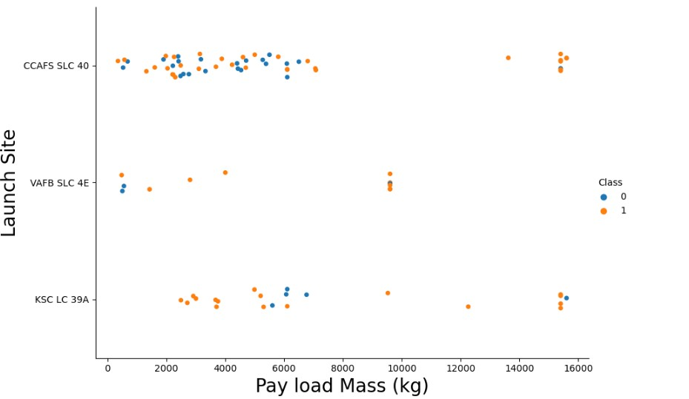
Payload vs. Launch Site
A scatter plot of Payload vs. Launch Site

Slide 26
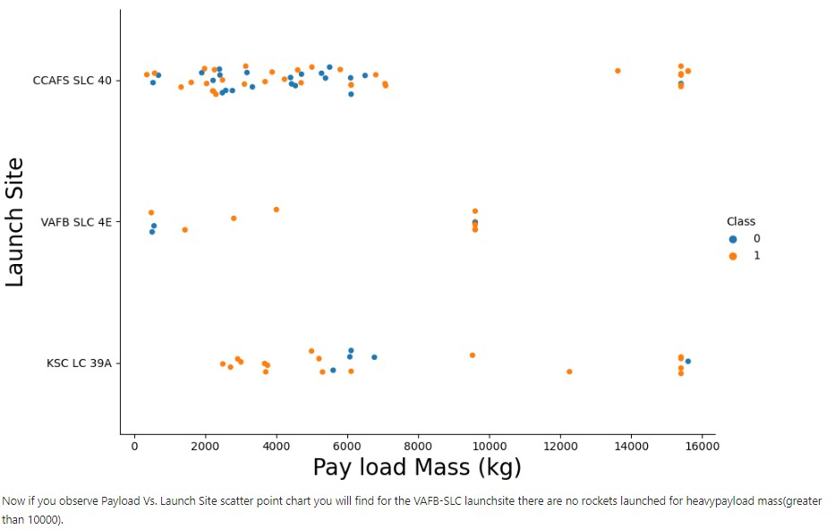
Payload vs. Launch Site with explanations
A scatter plot of Payload vs. Launch Site
2
6

Slide 27
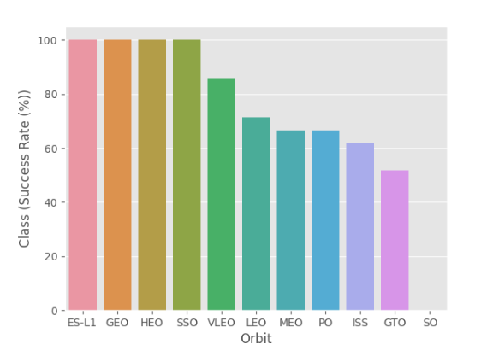
Success Rate vs. Orbit Type
Show a bar chart for the success rate of each orbit type

Slide 28
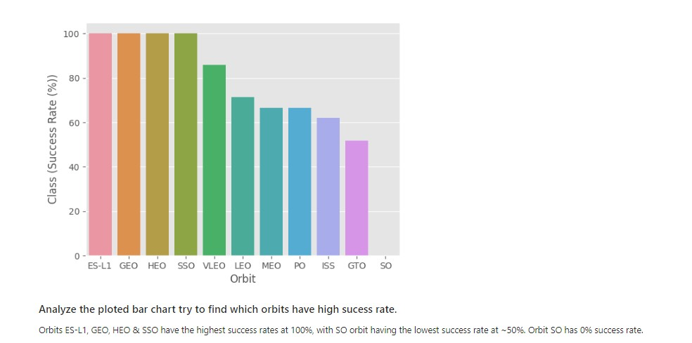
Success Rate vs. Orbit Type with explanations
Show the screenshot of the bar chart with explanations

Slide 29
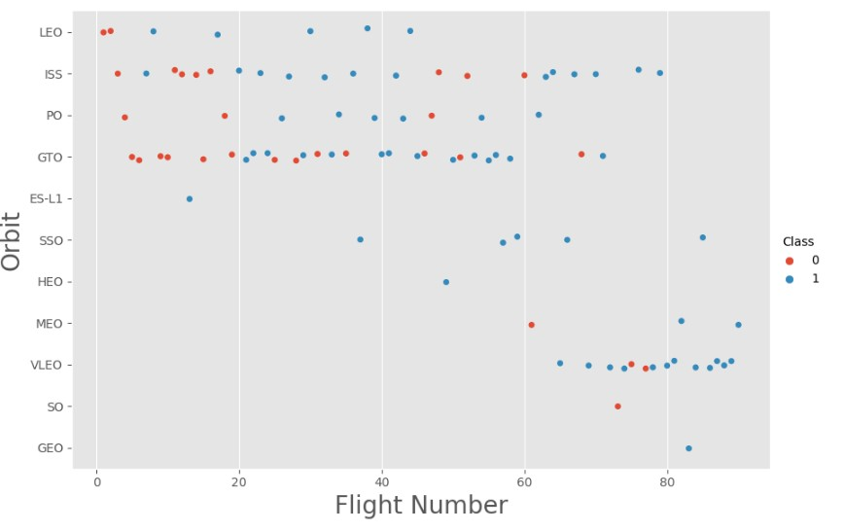
Flight Number vs. Orbit Type
A scatter point of Flight number vs. Orbit type

Slide 30
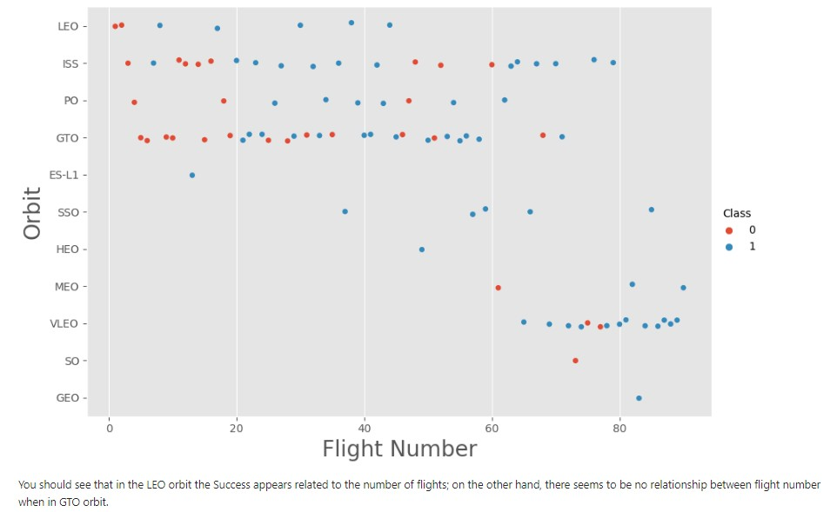
Flight Number vs. Orbit Typewith explanations

Slide 31
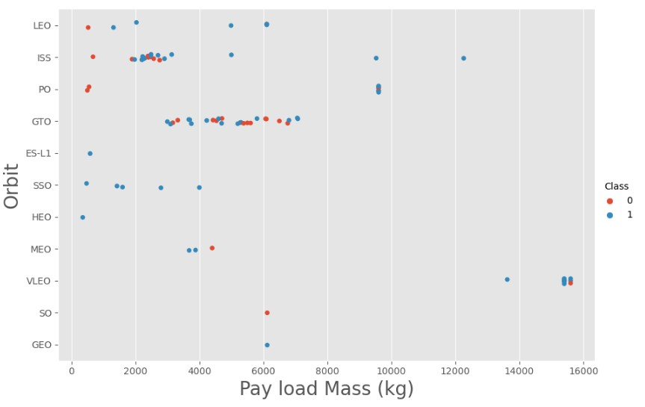
Payload vs. Orbit Type
With heavy
payloads the
successful landing
or positive landing
rate are more for Polar,LEO and ISS.
However for GTO
we cannot
distinguish this well
as both positive
landing rate and
negative
landing(unsuccessfu
l mission) both have
near equal chances.

Slide 32
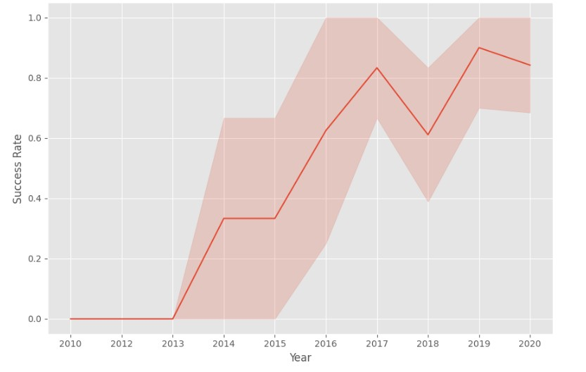
Launch Success Yearly Trend
A line chart of yearly average success rate
Since 2013, the
success rate kept going up till 2020
32

Slide 33
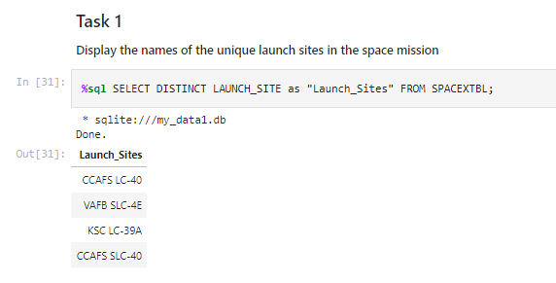
All Launch Site Names
Find the names of the unique launch sites
Used ‘SELECT DISTINCT’ statement to return only the unique launch sites from the ‘LAUNCH_SITE’ column of the SPACEXTBL table
33

Slide 34
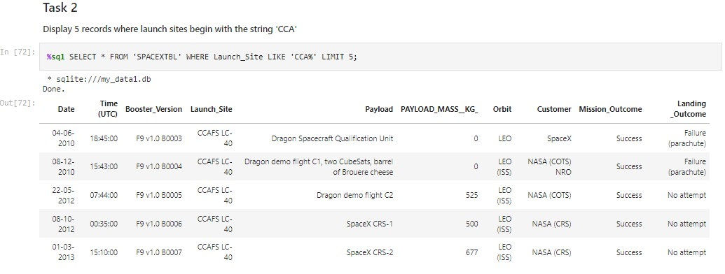
Launch Site Names Begin with 'CCA'
Find 5 records where launch sites begin with `CCA`
Used ‘LIKE’ command with ‘%’ wildcard in ‘WHERE’ clause to select and dispay a table of all records where launch sites begin with the string 'CCA'
34

Slide 35
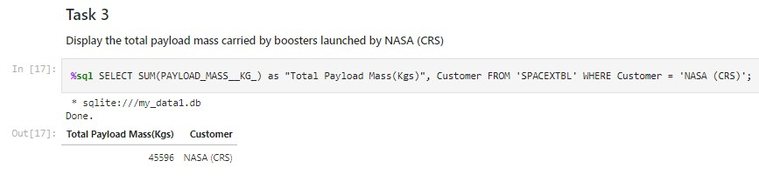
Total Payload Mass
Calculate and Display the total payload carried by boosters from NASA
Used the ‘SUM()’ function to return and dispaly the total sum of ‘PAYLOAD_MASS_KG’ column for Customer ‘NASA(CRS’

Slide 36
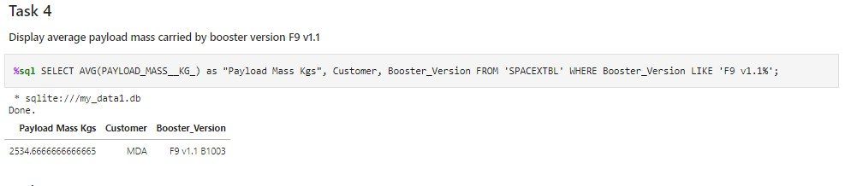
Average Payload Mass by F9 v1.1
Calculate the average payload mass carried by booster version F9 v1.1
Used the ‘AVG()’ function to return and dispaly the average payload mass carried by booster version F9 v1.1

Slide 37
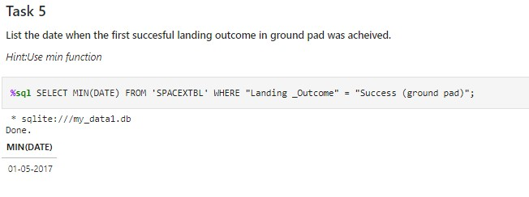
First Successful Ground Landing Date
Find the dates of the first successful landing outcome on ground pad
Used the ‘MIN()’ function to return and dispaly the first (oldest) date when first successful landing outcome on ground pad ‘Success (ground pad)’happened.
37

Slide 38
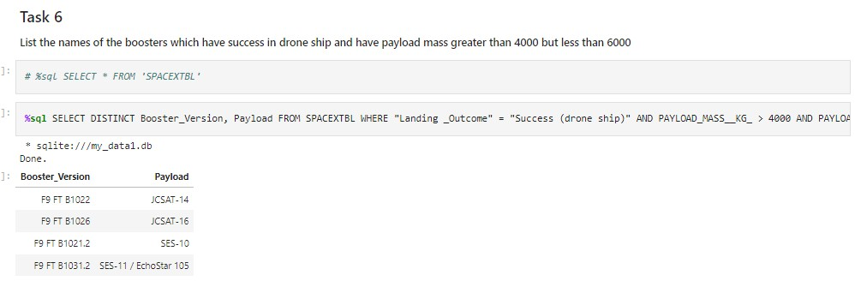
Successful Drone Ship Landing with Payload between 4000 and 6000
List of Boosters which have successfully landed on drone ship and had payload
mass greater than 4000 but less than 6000
Used ‘Select Distinct’ statement to return and list the ‘unique’ names of boosters with
operators >4000 and <6000 to only list booster with payloads btween 4000-6000 with
landing outcome of ‘Success (drone ship)’.
38

Slide 39
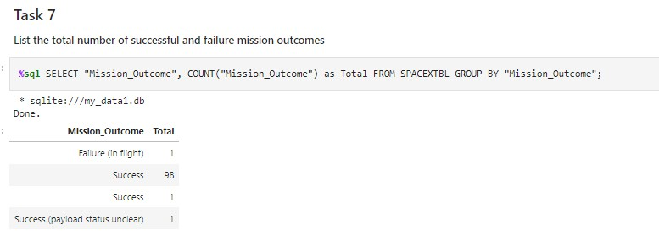
Total Number of Successful and Failure Mission Outcomes
Calculate the total number of successful and failure mission outcomes
Used the ‘COUNT()’ together with the ‘GROUP BY’ statement to return total number of missions outcomes
39

Slide 40
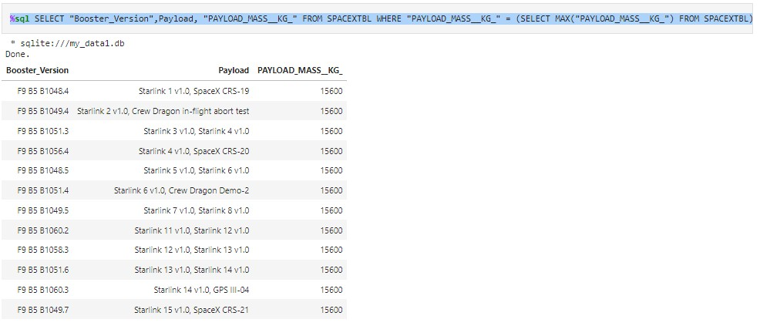
Boosters Carried Maximum Payload
List of the boosters which have carried the maximum payload mass
Using a Subquerry to return and pass the Max payload and used it list all the boosters that have carried the Max payload of 15600kgs
40

Slide 41
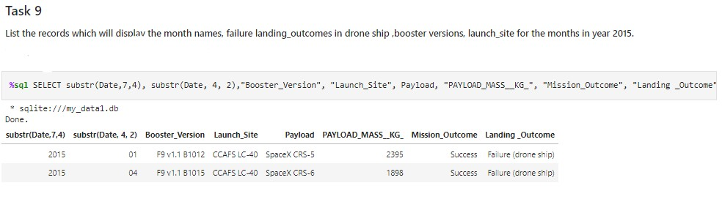
2015 Launch Records
List of failed landing outcomes in drone ship, with their booster versions, and launch site names in 2015
Used the ‘subsrt()’ in the select statement to get the month and year from the date column where substr(Date,7,4)='2015' for year and Landing_outcome was ‘Failure (drone ship₄₁’) and return the records nmatching the filter.

Slide 42
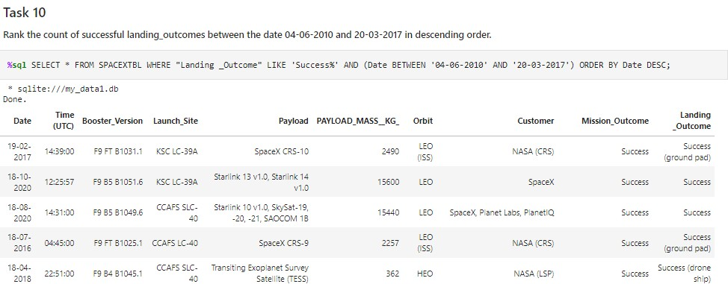
Rank Landing Outcomes Between 2010-06-04 and 2017-03-20
Rank the count of landing outcomes (such as Failure (drone ship) or Success (ground pad)) between the date 2010-06-04 and 2017-03-20, in descending order
42

Slide 43

Section 3
Launch Sites
Proximities Analysis

Slide 44
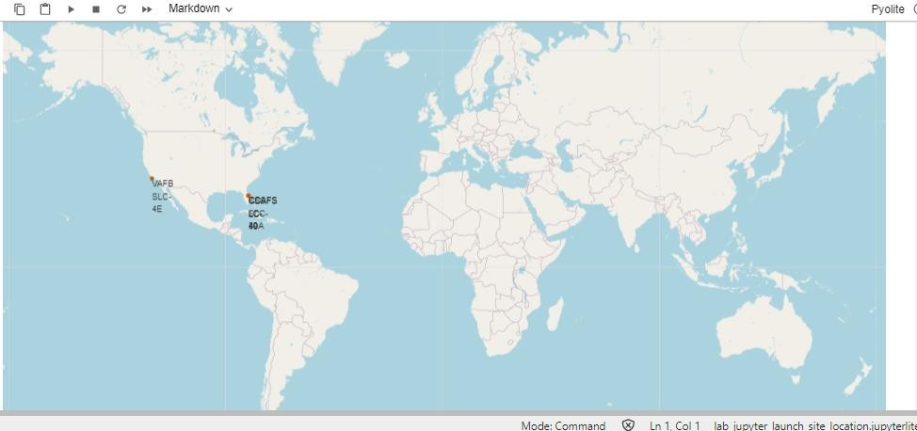
Markers of all launch sites on global map
All launch sites are in proximity to the Equator, (located southwards of the US map). Also all the laumch sites are in very close proximity to the coast.

Slide 45
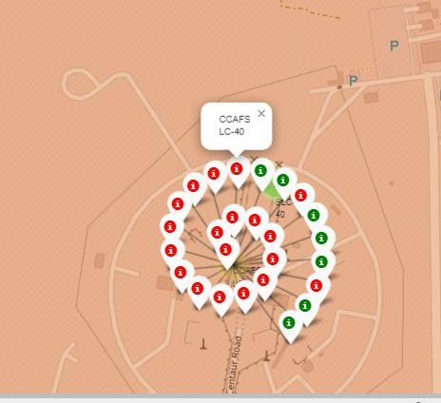
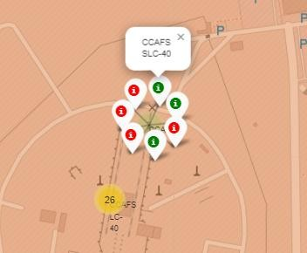
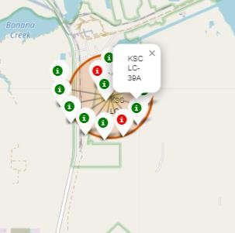
Launch outcomes for each site on the map With Color Markers
Florida Sites
In the Eastern coast (Florida) Launch site KSC LC-39A has relatively high success
rates compared to CCAFS SLC-40 & CCAFS LC-40.

Slide 46
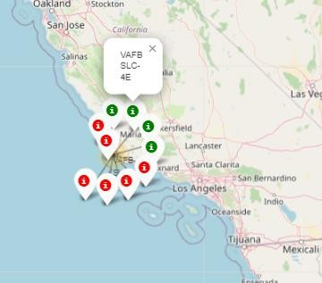
Launch outcomes for each site on the map With Color Markers
West Coast/ Carlifonia
In the West Coast (Californai) Launch site VAFB SLC-4E has relatively lower success rates 4/10 compared to KSC LC- 39A launch site in the Eastern Coast of Florida.

Slide 47
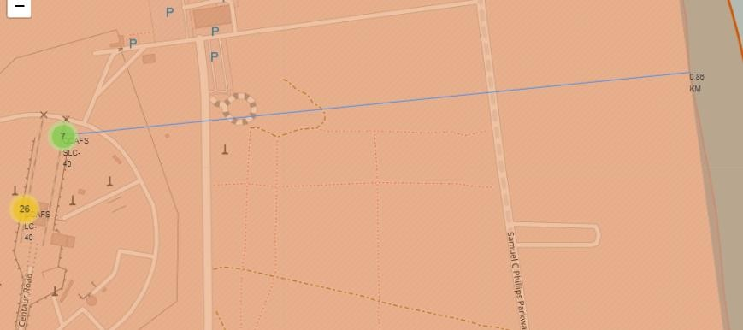
Distances between a launch site to its proximities
Launch site CCAFS SLC-40 proximity to coastline is 0.86km

Slide 48
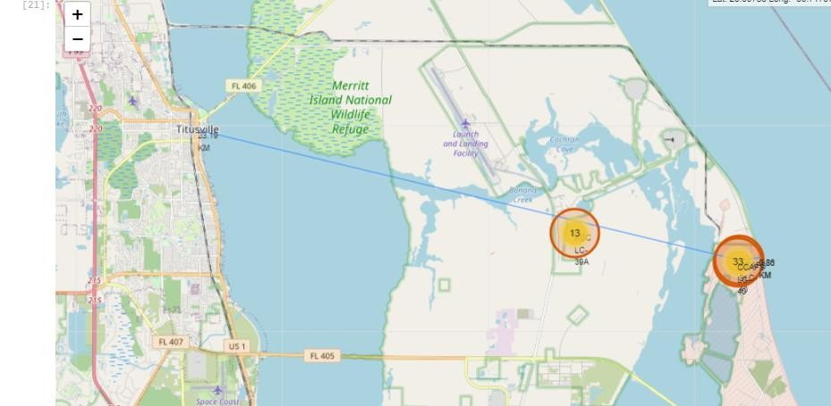
Distances between a launch site to its proximities
Launch site CCAFS SLC-40 closest to highway (Washington Avenue) is 23.19km
48

Slide 49

Section 4
Building a dashboard with Plotly

Slide 50
Pie-Chart for launch success count for all sites
Launch site KSC LC-39A has the highest launch success rate at 42% followed by CCAFS LC-40 at 29%, VAFB SLC-4E at 17% and lastly launch site CCAFS SLC-40 with a success rate of 13%
50

Slide 51
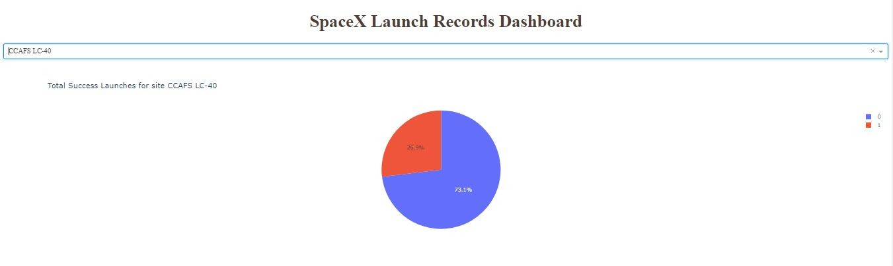
Pie chart for the launch site with 2nd highest launch success ratio
Launch site CCAFS LC-40 had the 2nd highest success ratio of 73% success against 27% failed launches
51

Slide 52
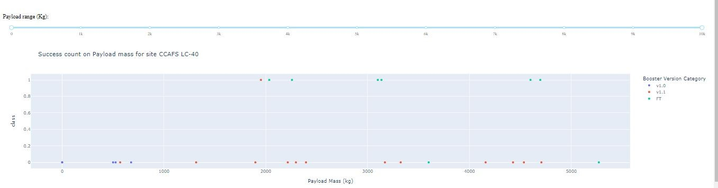
Payload vs. Launch Outcome scatter plot for all sites
For Launch site CCAFS LC-40 the booster version FT has the largest success rate from a payload mass of >2000kg
52

Slide 53

Section 6
Predictive Analysis
(Machine Learning Classification Methods)

Slide 54
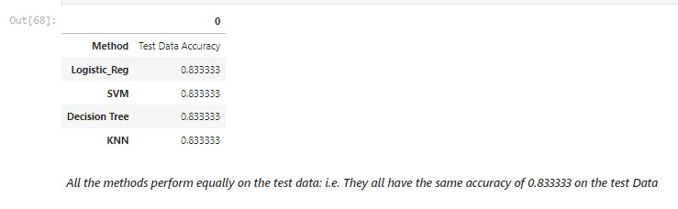
Classification Models Accuracy

Slide 55
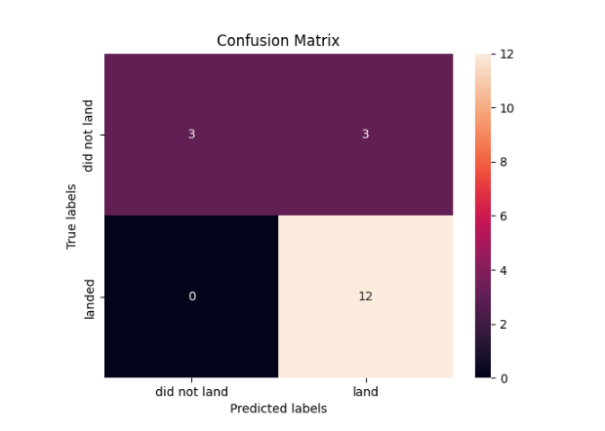
Confusion Matrix
All the 4 classification model had the same confusion matrixes and were able equally distinguish between the different classes. The major problem is false positives for all the models.

Slide 56
Conclusions
Different launch sites have different success rates. CCAFS LC-40, has a success rate of 60 %,
while KSC LC-39A and VAFB SLC 4E has a success rate of 77%.
We can deduce that, as the flight number increases in each of the 3 launcg sites, so does the success rate. For instance, the success rate for the VAFB SLC 4E launch site is 100% after the Flight number 50. Both KSC LC 39A and CCAFS SLC 40 have a 100% success rates after 80th flight
If you observe Payload Vs. Launch Site scatter point chart you will find for the VAFB-SLC
launchsite there are no rockets launched for heavypayload mass(greater than 10000).
Orbits ES-L1, GEO, HEO & SSO have the highest success rates at 100%, with SO orbit having the lowest success rate at ~50%. Orbit SO has 0% success rate.
LEO orbit the Success appears related to the number of flights; on the other hand, there seems
to be no relationship between flight number when in GTO orbit

Slide 57
Conclusions Cont….
With heavy payloads the successful landing or positive landing rate are more for Polar,LEO and ISS. However for GTO we cannot distinguish this well as both positive landing rate and negative landing(unsuccessful mission) are both there here
Anf finally the sucess rate since 2013 kept increasing till 2020.

Slide 58


